Slide 1
NYC Taxi and
Restaurant Issues
Group 3
Dhruv Sharma, Pasang Syangba, Maung Aung, Sujasna Tamang

Slide 2
Context
01
02
03
04
Introduction
KPIs & Dimensional Model
ETL Transformation
Visualization

Slide 3

Service on the Street and at the Table:
NYC Taxi and Restaurant Analysis
Overview
A comprehensive investigation into the relationship between taxi complaints and restaurant inspection results in New York City. This project aims to uncover patterns that could improve service quality and public safety in the city.

Slide 4
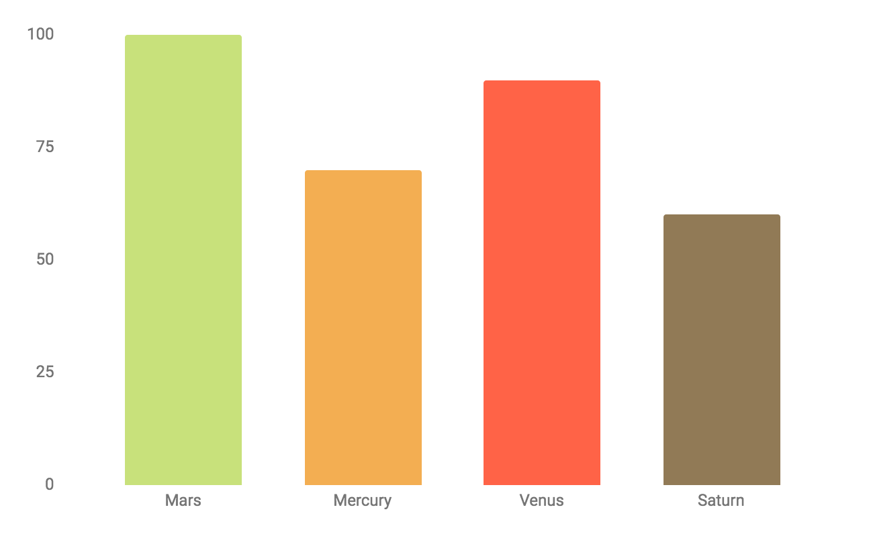

Source Datasets Overview
311 Taxi Complaints Dataset:
Description: Public complaints about taxi services in NYC.
Key Metrics: Unsafe driving, pickup refusals, route complaints.
Source: NYC Open Data
DOHMH Restaurant Inspection Results Dataset:
Description: Health inspection records for NYC restaurants.
Key Metrics: Inspection grades, critical violations, compliance scores.
Source: NYC Open Data

Slide 5
Key Performance Indicators (KPIs)
Taxi Complaints
Total Number of Complaints by Type
Number of Complaints by Location Type
Complaint Frequency by Time of Day
Average Day of Complaint Closure by Agency
Number of Complaints by Status
Number of Complaints by Month.
Restaurant Inspections
Number of inspections by Inspection Type
Number of Inspection scores by Zip Code
Number of Inspections by Grade
Total Number of Complaints by Critical Flag
Number of Inspections by Month

Slide 6
Dimensions for Taxi Complaint
and Restaurant Inspection
Taxi Complaint
Complaint type
Location
Time
Date
Agency
Status
Restaurant Inspection
Inspection type
Location
Grade
Violation description
Critical flag
Date
Restaurant type

Slide 7
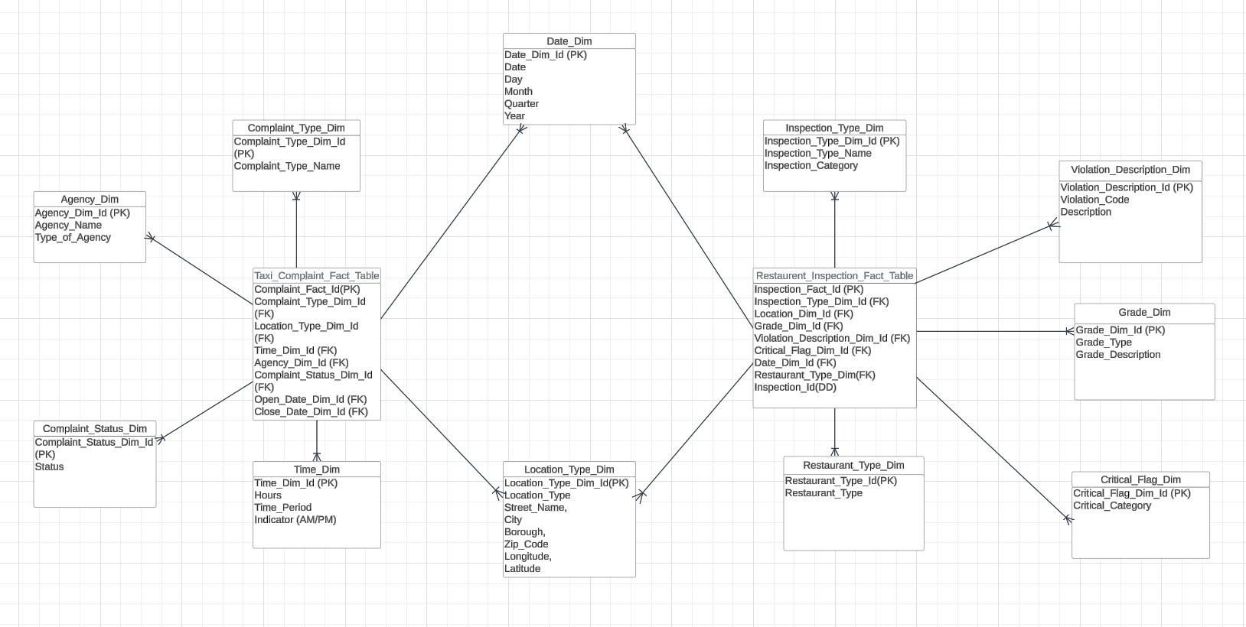

Integrated Star Schema

Slide 8
ETL: 311_Taxi_Complaints
Extract Data from BigQuery and APIs
Structure and Export for Analysis
Pull raw data from NYC Open Data APIs and BigQuery tables containing complaints, taxi trip details, and related datasets.
Organize Data: Categorize by time, location, complaint types, and agencies.
Export: Save cleaned datasets to CSV for analysis.
02
04
01
03
05
Install Dependencies and Authenticate
Transform and Clean Data
Save and Store Results
Set up environment: Install Python libraries like pandas and sodapy for data extraction and manipulation.
Authenticate: Connect to APIs and BigQuery for dataset access
Process the raw data by handling missing values, standardizing columns, and ensuring data integrity for seamless analysis.
store results back into BigQuery or local files for visualization, reporting, and decision-making.

Slide 9
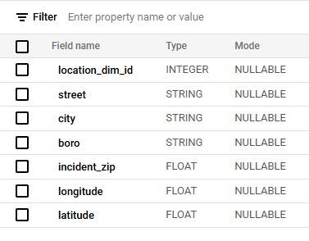
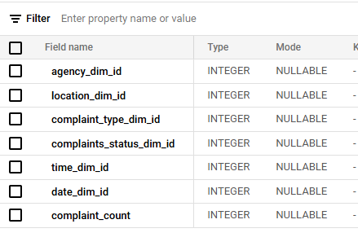
Taxi Dimensions and Fact Table
Creating Dimensions
Creating the Fact Table
Dimensions like Location, Time, and Complaint Type are created by extracting raw data fields (e.g., street, city, borough, incident_zip).
These are cleaned, categorized, and structured into separate tables for better organization and analysis.
The Fact Table combines keys from multiple dimensions, such as location_dim_id, time_dim_id, and agency_dim_id.
It includes aggregated metrics like the complaint_count to provide a centralized view for analysis.

Slide 10

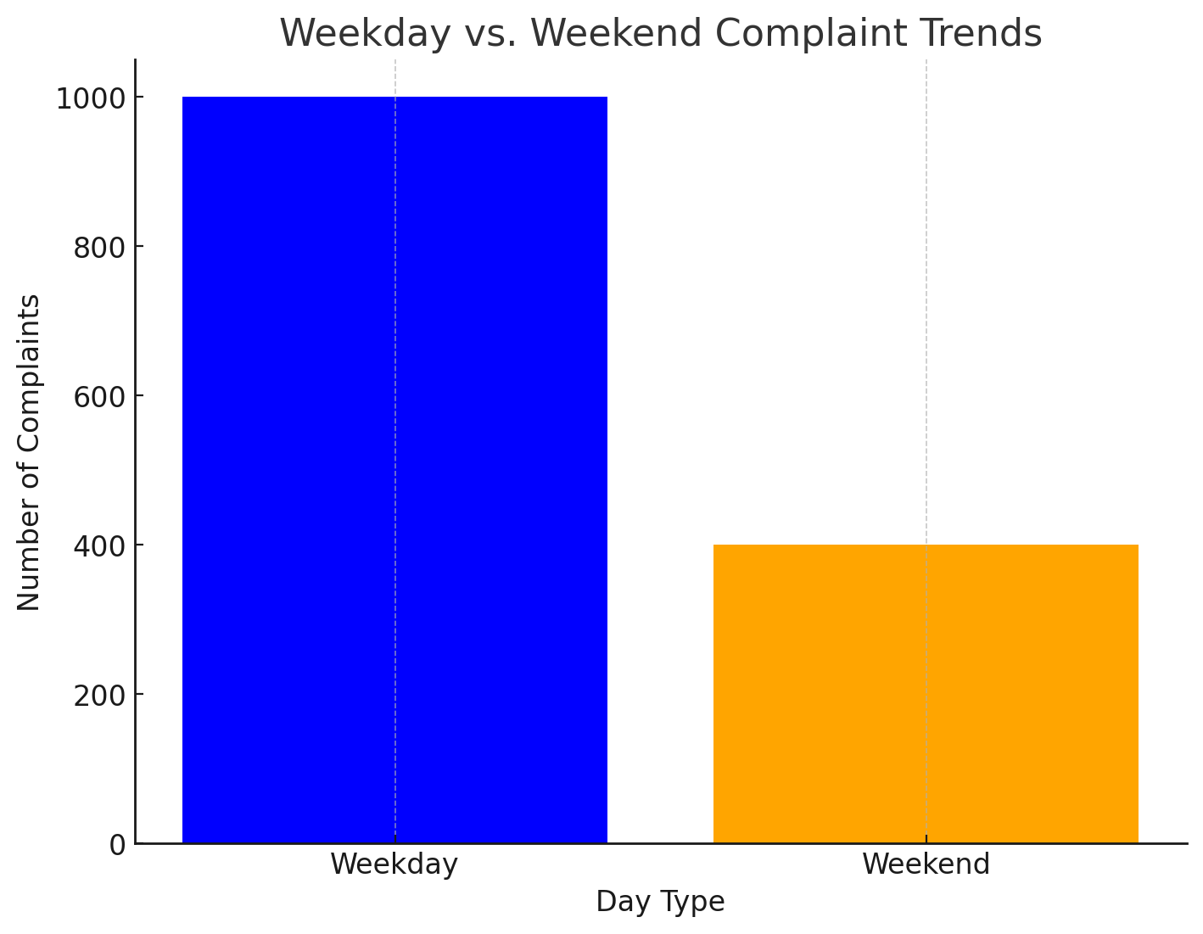
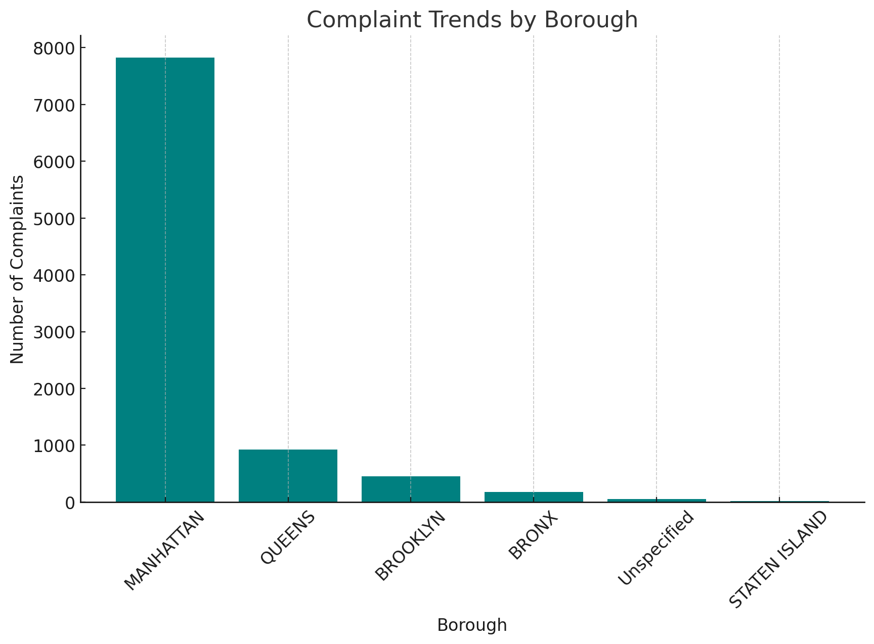
Visualization for Taxi_Complaints
Weekday vs. Weekend Complaint Trends
Complaint Trends By Borough
This comparison reveals patterns in complaints based on day type, aiding in optimizing resource availability
This chart highlights complaint trends across boroughs, helping to identify areas with higher complaint densities for better resource allocation.

Slide 11
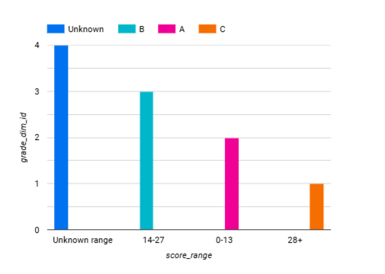
Restaurant Transformation
Data Enrichment
Grade Categories
Grade A
Grade B
Grade C
Grade P, N and Z
Transformation Process
pd.cut()
Data Binning
Grade A (Excellent) for scores between 0-13
Grade B (Good) for scores between 14-27
Grade C (Fair) for scores above 28
Unknown

Slide 12
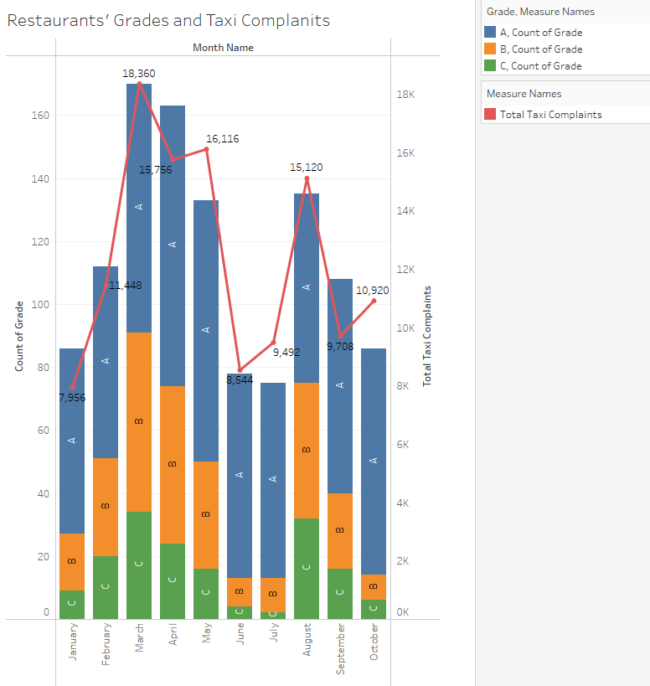
Monthly Trends of Restaurant Grades and Taxi Complaints
The graph showing restaurant grades (A, B, and C) alongside total taxi complaints by month.

Slide 13
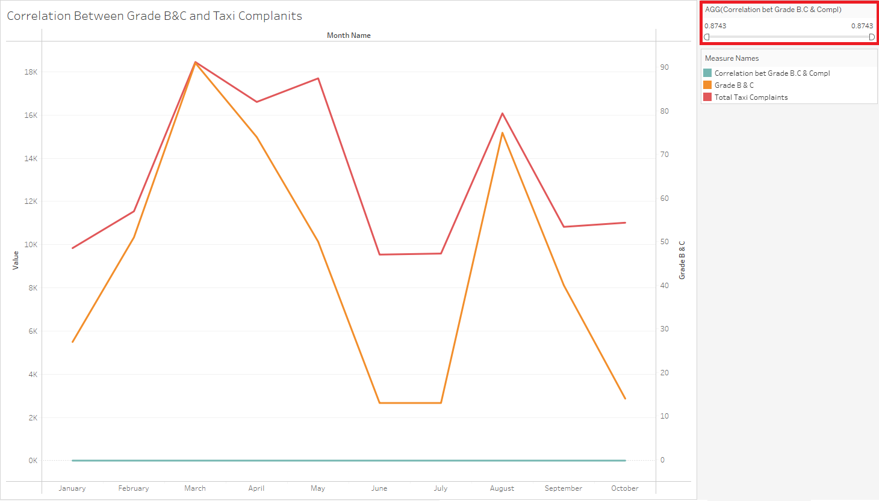
Correlation Between Lower Restaurant Grades (B & C) and Taxi Complaints
Highlights neighborhoods with higher concentrations of Grade B and C restaurants.
Shows a strong positive correlation of 0.87 with taxi complaints.
Indicates that as Grade B and C restaurant counts increase, taxi complaints also rise.

Slide 14
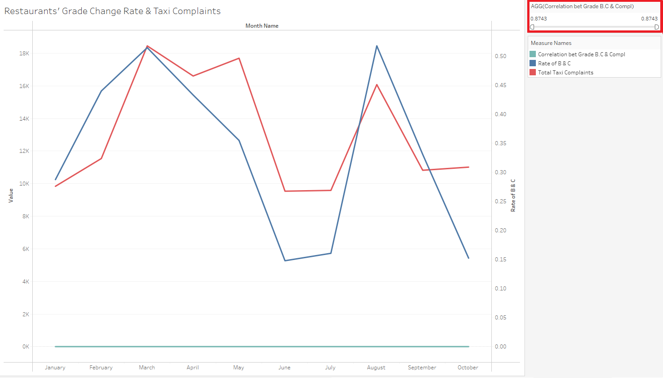
Relationship Between Lower Restaurant Grades (B & C) Ratio and Taxi Complaints
Displays the ratio of Grade B & C restaurants to all grades over time.
The blue line (B & C ratio) and red line (taxi complaints) follow similar patterns, with a correlation value of 0.87.
Supports the hypothesis that a higher B & C ratio correlates with more taxi complaints.

Slide 15
Conclusion
This project demonstrates that the safety and service quality of a borough can be evaluated through taxi complaint and restaurant inspection results but other factors must also be considered for a comprehensive assessment.
Integrating diverse datasets enables a deeper understanding of community challenges and opportunities for improvement.
The results underscore the importance of data-driven approaches to enhance public safety and service standards in New York City.

Slide 16
THANK YOU!!!

